Slide 1

Heading
Department of Computer Science
Rollwala Computer Centre
Presented By:
Antra Koul - 13
Aqueed Shaikh - 24
Under the guidance of :
Dr. Hardik Joshi

Slide 2
What is Version Control?
Version control is a class of systems responsible for managing changes to computer programs, documents etc , based around tracking changes that happen within directories or files.
Version control tools are used for the following objectives:
    Allows you to revert selected files back to a previous state or revert the entire project back to a previous state.
    Compare changes over time of a project.
    See who last modified something that might be causing a problem, who introduced an issue and when.
    If you mess things up or lose files, you can easily recover.

Slide 3
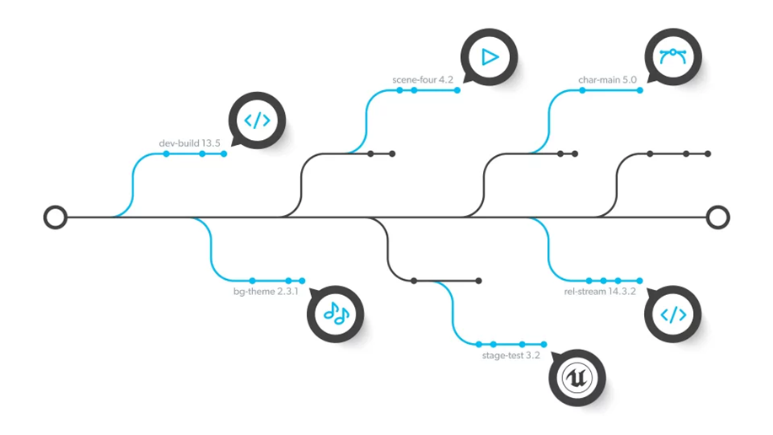
What is Version Control?
Working of version control :

Slide 4
The Need For Version Control
Constant communication vehicle for the team, whether they are in the same room, or around the globe.
Preserves the individual contributions of team members without overwriting another developer's work, and then merges and reconciles changes and updates.
Acts as a backup.

Slide 5
Literature Survey – Research Papers

Slide 6
Paper - I
Title: Evolution of Version Control Systems and a study on TortoiseSVN
Authors: Pratik P Bhoir, Harshali Patil
Published In: International Research Journal of Engineering and Technology (IRJET)
Year of Publication: 2018

Slide 7
History of Version Control Systems
The Emergence:
Source Code Control System (SCCS) came into play. The SCCS was designed to track changes in the source code and other text files during the software development.
It was developed at Bells Lab in 1972 by Marc Rochkind and it was implemented on IBM System/370 computer running OS/360.
Soon later Revision Control System (RCS) replaced SCCS.

Slide 8
History of Version Control Systems
The Classic Phase:
In 1990, VCS moved into new phase. The Concurrent Version System (CVS) was developed by Dick Grune as a series of shell scripts. It uses a Client-Server architecture.
The CVS is a type of Centralized Version Control System (CVCS) which allowed many developers to work on the same file at the same time.
It was the first which supported Merging and Branching but it was didn’t worked efficiently.

Slide 9
History of Version Control Systems
The Post-Classic Phase:
Post classic phase of the VCS, came the concepts of Subversion (SVN). It is the open source Centralized version control system under the Apache Licence .
It maintains the versioning for files, directories, the file metadata and the renames.
The users can copy and/ or move entire directory-hierarchy very quickly and easily, while retaining full revision history.

Slide 10
History of Version Control Systems
The Modern Phase:
There came a renaissance in the year 2009-2010 with the introduction of GIT and its like. GIT is a Distributed Version Control System (DVCS).
Linus Torvalds developed GIT in year 2005 with an aim to increase speed, data integrity and support for distributed and, non-linear workflow.
GIT provides a support for non-linear development of the software. It supports quick branching and merging and also includes tools for navigating and visualizing a non-linear development history.

Slide 11

Git-Hub

Slide 12
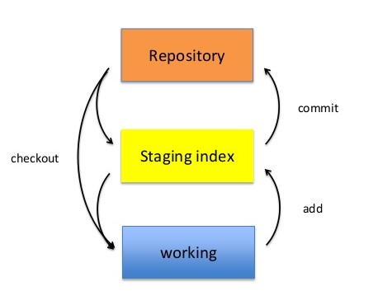
Git Hub Architecture
It has a three tier architecture

Slide 13
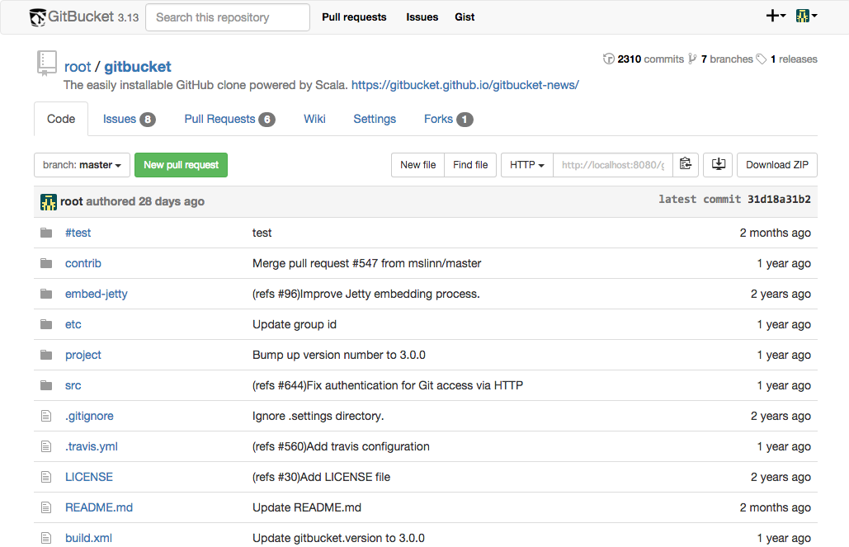
Git Hub Interface

Slide 14
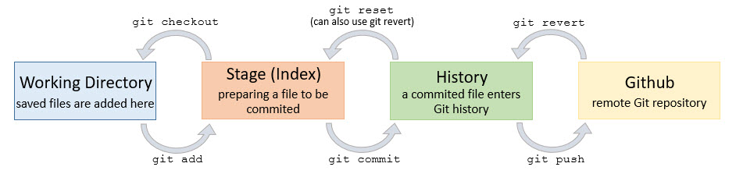
Git Hub Commands

Slide 15
Features
Collaborative Coding
  Contribute to projects quickly with automatic environment setup.
  Make sure you see the changes you care about.
Automation and CI/CD
  Automate everything: CI/CD, testing, planning, project management, issue labeling, approvals, on boarding, and more.
  Standardize and scale best practices, security, and compliance across your organization.

Slide 16
Features
Security
  Secure code as you write it. Automatically review every change to your codebase and identify vulnerabilities before they reach production.
  Understand and address any vulnerabilities in your open source dependencies.
Client Apps
  Take GitHub with you on any connected device.
  Skip the visual UI with a quick, powerful text interface.

Slide 17
Features
Project Management
  Give your team continuously updated information on your progress, priorities and roadmap.
  Track what you deliver down to the commit.
Team Administration
  Simplify access and permissions management across your projects and teams.
  Update permissions, add new users as you grow, and give everyone the exact permissions they need.

Slide 18
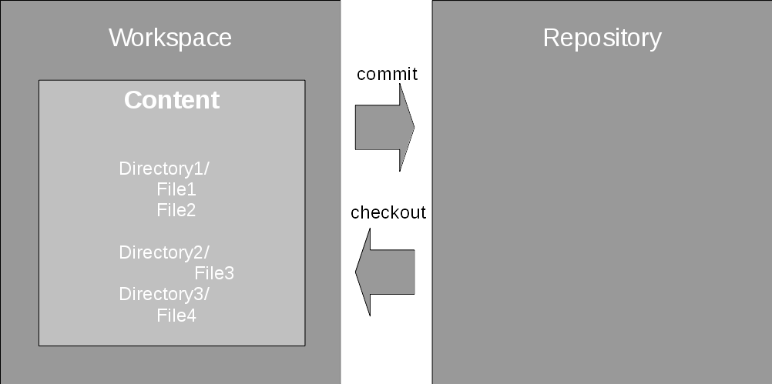
Working with GIT

Slide 19
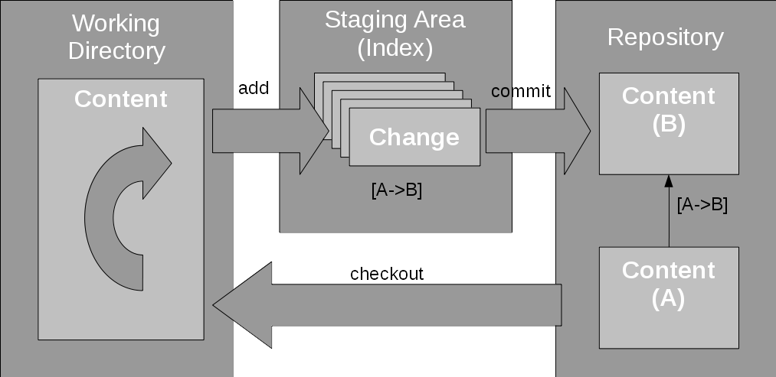
Working with GIT

Slide 20
Paper - II
Title: No Single Metric Captures Productivity
Authors: Ciera Jaspan, Caitlin Sadowski
Published In: Rethinking Productivity In Software Engineering
Year of Publication: 2019

Slide 21
Why Do People Want to Measure Developer Productivity?
identifying high/low-performing individuals and teams
rating the effectiveness of different tools or practices
running comparisons for an intervention meant to improve productivity,
highlighting inefficiencies where productivity can be improved.

Slide 22
What’s Inherently Wrong with a Single Productivity Metric?
Productivity Is Broad
  Creating a metric would examine a thin slice of a developer’s overall time and output.
  Developers engage in a variety of other development tasks beyond just writing code, including providing guidance and reviewing code for other developers, designing systems and features, and managing releases and configuration of software systems
  Even for the narrow case of measuring productivity of developers in terms of code contributions, quantifying the size of such contributions misses critical aspects of code such as quality, or maintainability.

Slide 23
What’s Inherently Wrong with a Single Productivity Metric?
Flattening/Combining Components of a Single Aspect Is Challenging
  flattening all qualities into a single measure along with quantity has limited applicability and risks, reducing the action ability of a metric.
  Is a developer with few code contributions of very high quality more or less productive than a developer with many contributions but some quality issues?
  For example, if a variety of factors (e.g., cyclomatic complexity, time to complete, test coverage, size) are compressed into one number representing the productivity impact of a patch.

Slide 24
What’s Inherently Wrong with a Single Productivity Metric?
Confounding Factors
  Even if we are able to tease out a single metric that holistically covers some aspect of productivity, confounding factors can make the metric meaningless.
  Example: In case of comparing programming languages it’s difficult to measure the productivity of languages in particular because of
    language itself
    tools
    libraries
    culture
    types of projects
    types of developers who are attracted to that language.

Slide 25
What’s Inherently Wrong with a Single Productivity Metric?
Confounding Factors
  There can even be externalities that are not captured within a metric.
  For example, one team might appear to be submitting fewer lines of code than another team. Perhaps the team is taking more steps to improve quality and therefore has fewer bugs down the road

Slide 26
Conclusion
There is no single productivity metric for software engineers.
Instead, focus on a set of custom metrics targeted to a specific question.

Slide 27
Paper - III
Title: Software Developer Performance Measurement Based on Code Smells in Distributed Version Control System
Authors: Natach Jongprasit and Twittie Senivongse
Published In: International Conference on Software Engineering, Artificial Intelligence , Networking and Parallel/ Distributed Computing
Year of Publication: 2019

Slide 28
Introduction
This paper proposes a method and a supporting tool for measuring the performance of individual software developers in a Git project based on code smells.
The number of bad smells in the code can be considered as one of the code quality aspects of the developer performance.

Slide 29
Implementation smells
Implementation smell | Description
Complex conditional | A complex conditional statement
Complex method | A method with high cyclomatic complexity
Duplicate code | A code clone within a method
Empty catch block | A catch block of an exception is empty
Long identifier | An identifier with excessive length
Long method | A method is excessively long
Long parameter list | A method has long parameter list
Long statement | An excessively long statement
Magic number | An unexplained number is used in an expression
Missing default | A switch statement does not contain a default Case

Slide 30
Code Smells
Code smells are symptoms of poor design and implementation choices in the code which may indicate deeper problems and affect program maintainability.
Code smells are not bugs as code still functions but they may lead to bugs and failure in the future.

Slide 31
Categories of code smells
Implementation smells
  Code structures that indicate potential problems in the implementation,
Design smells
  Code structures that violate fundamental design principles.

Slide 32
Method to Measure Performance of Individual Software
Developer

Slide 33
Method to Measure Performance of Individual Software
Developer
Measuring the performance of a developer considers only the commits made by adding or modifying source code.
In Figure, all six code snapshots (i.e. initial code, commits C1-C4, and code at the pull request) are scanned for code smells.
The initial codebase and the code snapshot created by the pull request are scanned, so that the detected code smells will be used further to calculate developer performance.

Slide 34
Performance Score Calculation Based on Previous Code Snapshot
All developers who previously have committed changes to the source code may have their share of the smells found in a particular code snapshot.
Therefore, the performance of the developer who commits that code snapshot is based on whether he/she has improved the quality of the code, compared with the previous version of the code snapshot
That is, the developer would be considered as having good performance if he/she can reduce the smell density by fixing some smells in the previous version of the code and not adding many new smells to the added and modified code in the version that he/she has committed.

Slide 35
Conclusion
proposes a method and a set of metrics, based on Bayesian average rating, to compute individual performance of developers in a software project in which the collaboration is via a distributed version control system like Git.

Slide 36
Paper - IV
Title:Analysis of Software Developer Activity on a Distributed Version Control System
Authors: Shu Li*, Hayato Tsukiji*, and Kosuke Takano**
Published In: 2016 30th International Conference on Advanced Information Networking and Applications Workshops (WAINA)
Year of Publication: 2016

Slide 37
Introduction
A method of feature extraction based on those developers’ history of collaborative development using a distributed version control system has been presented.
Real Git projects on GitHub were experimentally analyzed, and the experimental results demonstrate the feasibility of our proposed method.
Proposed method allows us to analyze each developer’s characteristics in terms of “strong development areas (M/V/C)”, “contribution”, “initiative”, “support”, and “leadership” in progressing software development on a Git project.

Slide 38
Data available using Git-Hub API
Project Name
Overview
Name of Developer
Name of project Owner
URL
Commit Message
Programming language and amount in which they are used
C
Node.js
JS
PHP
HTML 5

Slide 39
Items that can be analyzed using proposed model
Analysis of MVC Framework
Model
View
Controller
  Analysis of Developer
(A)String development area(M/V/C)
(B)Contribution
(C)Initiative
(D)Support
(E)Leadership

Slide 40
Example of Analysis result for a Software Development project using Laravel

Slide 41
Analyzer
Git Projects on Git-Hub
Functions for extraction of Development features
Functions of analysis of development status in MVC framework
Providers for MVC Framework analysis
(A)Extraction of development area
(1)Analysis of MVC Architecture
Laravel provider
(B)Extraction of contribution
(2)Count of no. of source codes newly committed in each MVC layer
Ruby On Rail provider
(C)Extraction of initiative
(3)Count of no. of source codes modified by other developers in each MVC layer
Java Spring 4 provider
(D)Extraction of support
(4)Count of number of function calls in each MVC layer
(E)Extraction of leadership
Xxx Provider
(5)Count of number of configuration files/tools committed

Slide 42
Conclusion
By means of experiments using real Git projects on GitHub, method has been developed that allows us to extract the characteristics of software developers with regard to “strong development areas (M/V/C)”,“contribution”, “initiative”, “support”, and “leadership” based on an MVC framework analysis of a Git project

Slide 43
Aim
Retrieve information from a GitHub repository and bifurcate each contributor’s statistics.
Generate different metrics for each contributor to evaluate behavioural traits using the information retrieved.
Rank the contributors on the basis of their evaluated metrics.

Slide 44
Dataset
For the dataset, we have retrieved information from a repository in GitHub.
The information includes the follow information:
  Commit ID
  Commit Author
  Commit Message
  Commit Date
  Lines Added
  Lines Deleted

Slide 45
Dataset

Slide 46
Performance Evaluation factors
Total Contribution (expressed in form of lines of code)
Consistency (expressed in form of Code to Commit Ratio)
Regularity (expressed in form of plots)

Slide 47
Total Contribution
Metrics used for total contribution:
  Total Lines of Code
  Total Number of Commits

Slide 48
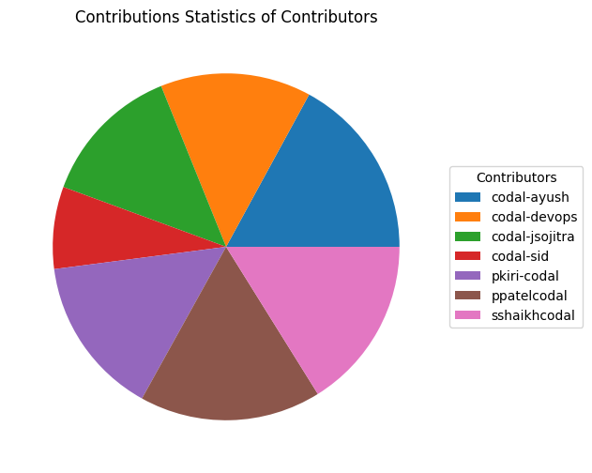
Total Contribution
Total Lines of Code

Slide 49
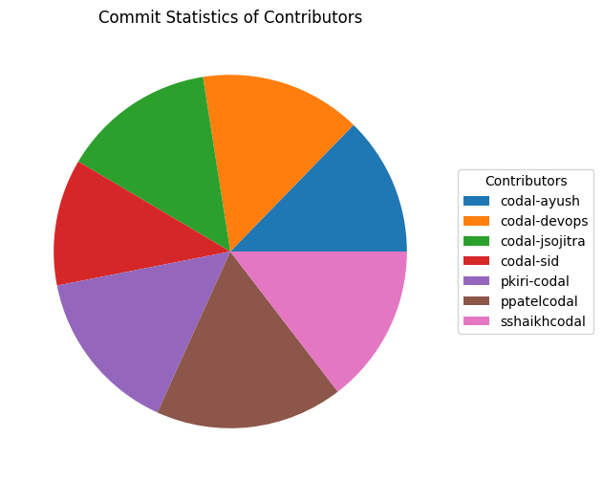
Total Contribution
Total number of commits

Slide 50
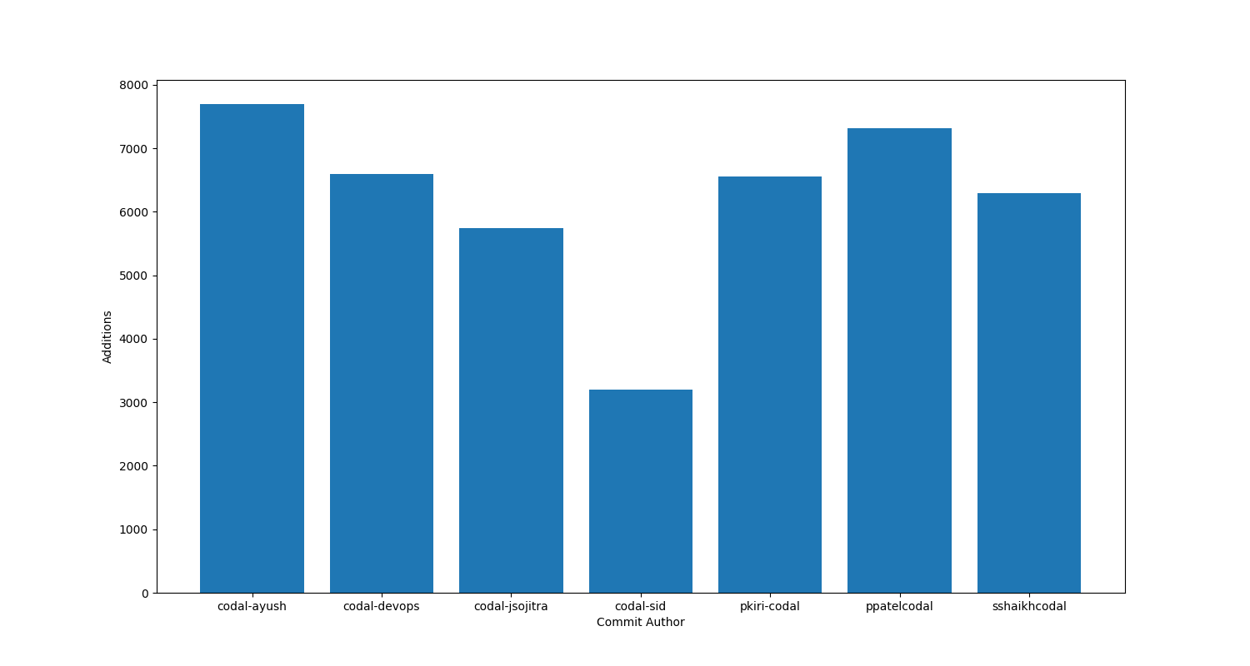
Consistency
It can be obtained based on the code per commit ratio.
Code per commit ratio = Ratio between total number of commits and total number of lines of code.

Slide 51
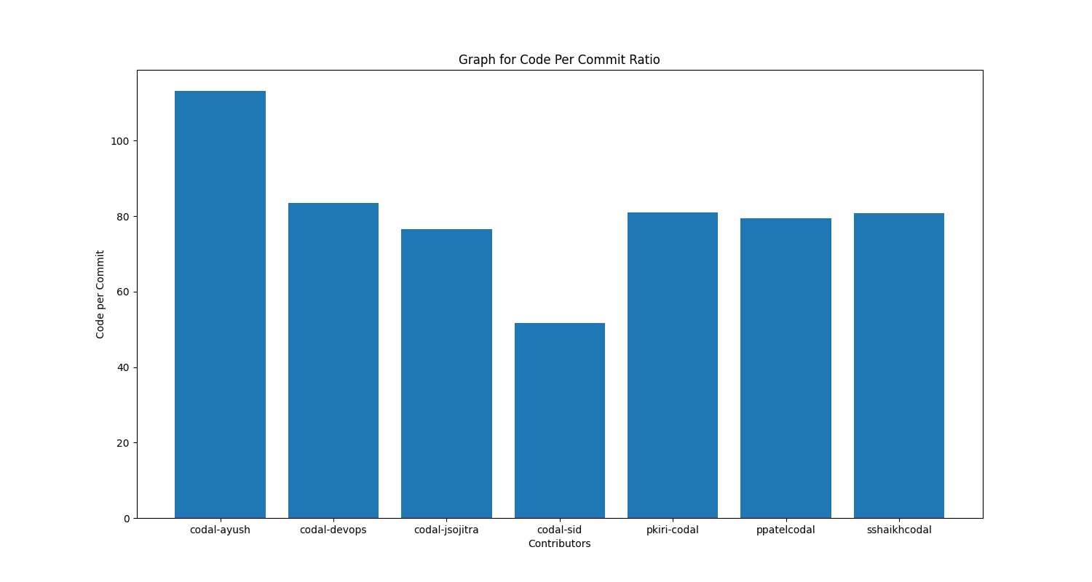
Consistency

Slide 52
Regularity
Can be measured by observing how regularly the contributor commits code to the repository.
Time frame may differ in each case, so observing pictorial representation like plots are helpful.

Slide 53
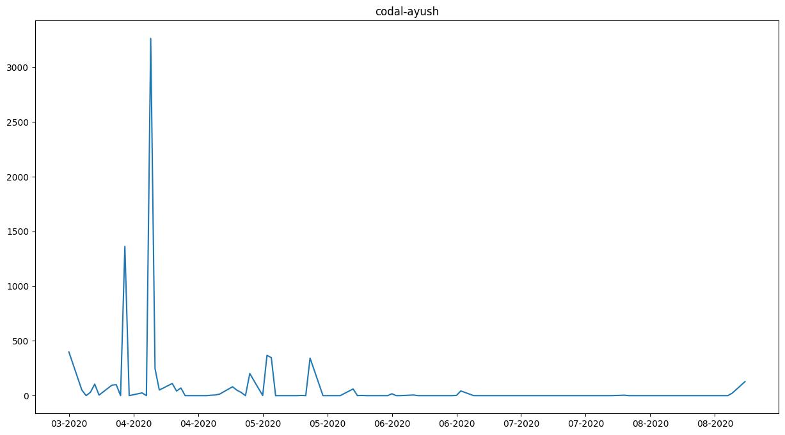
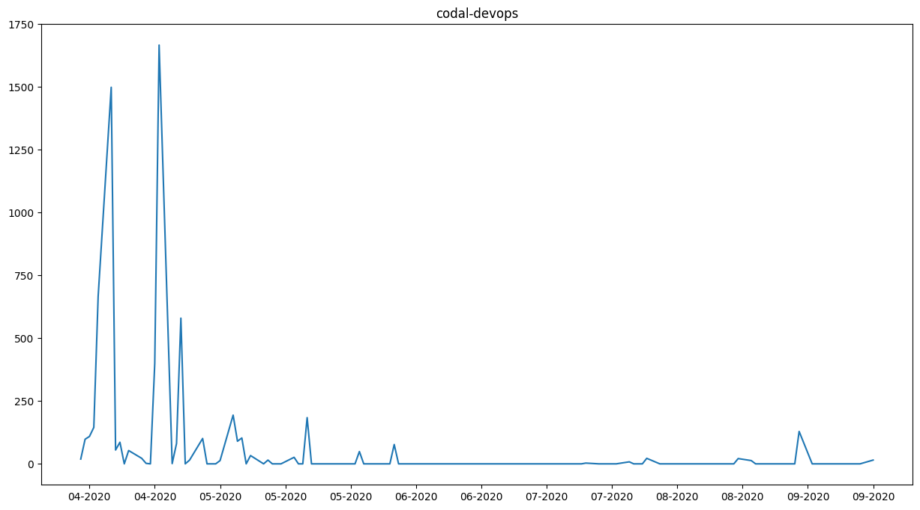
Regularity

Slide 54
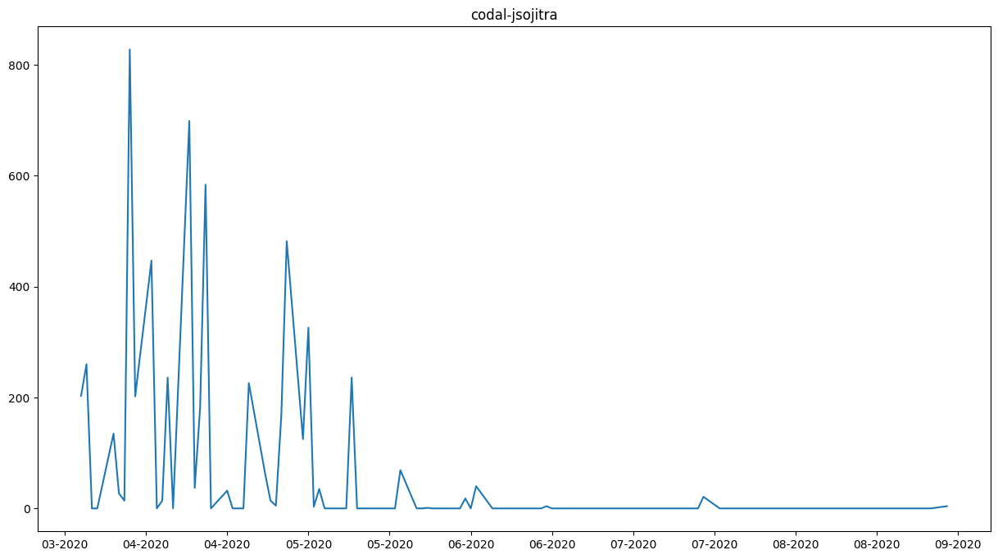
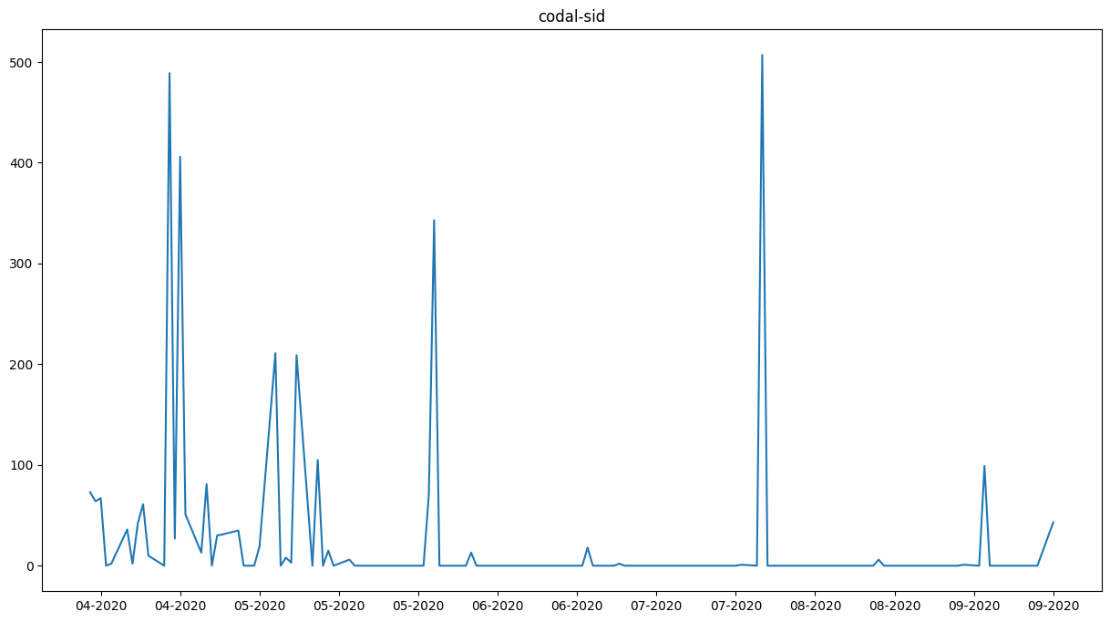
Regularity

Slide 55
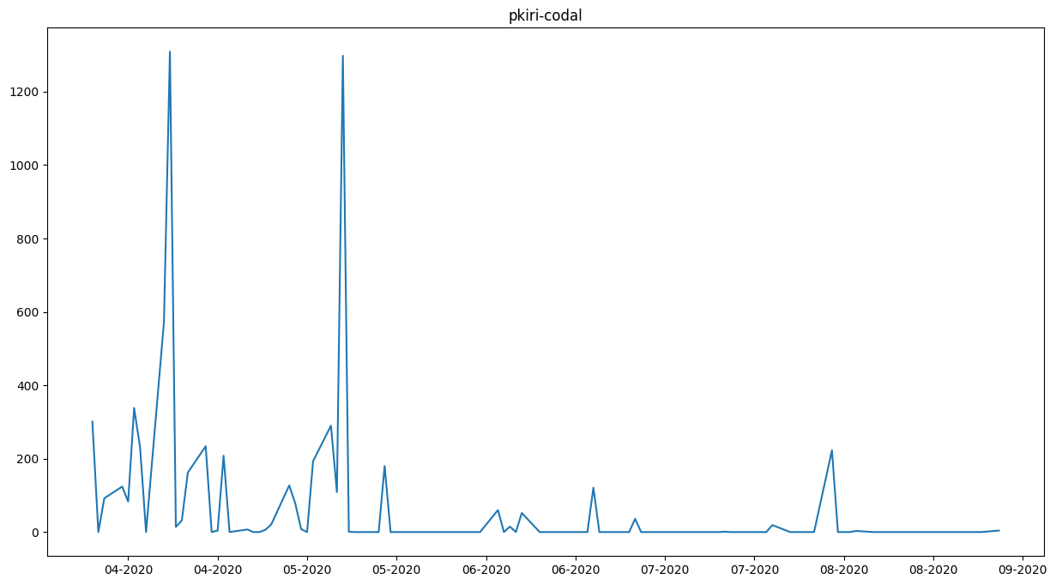
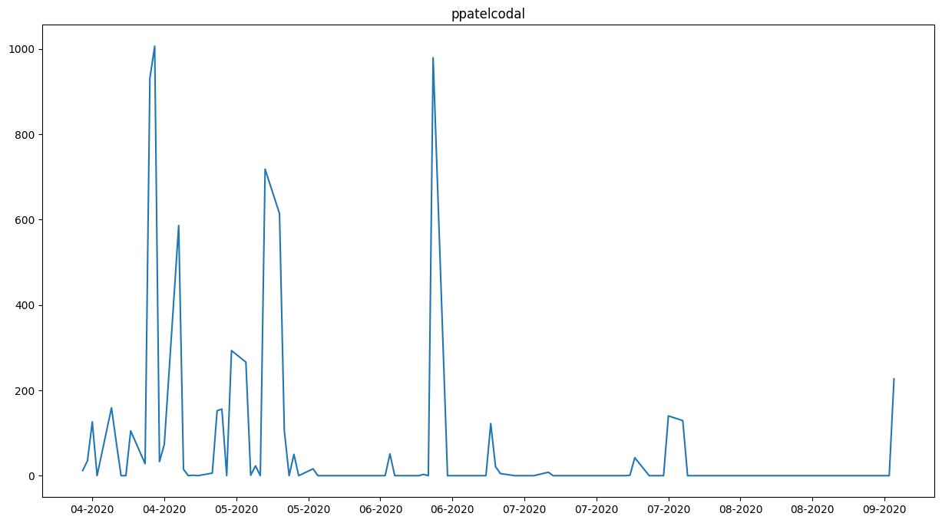
Regularity

Slide 56
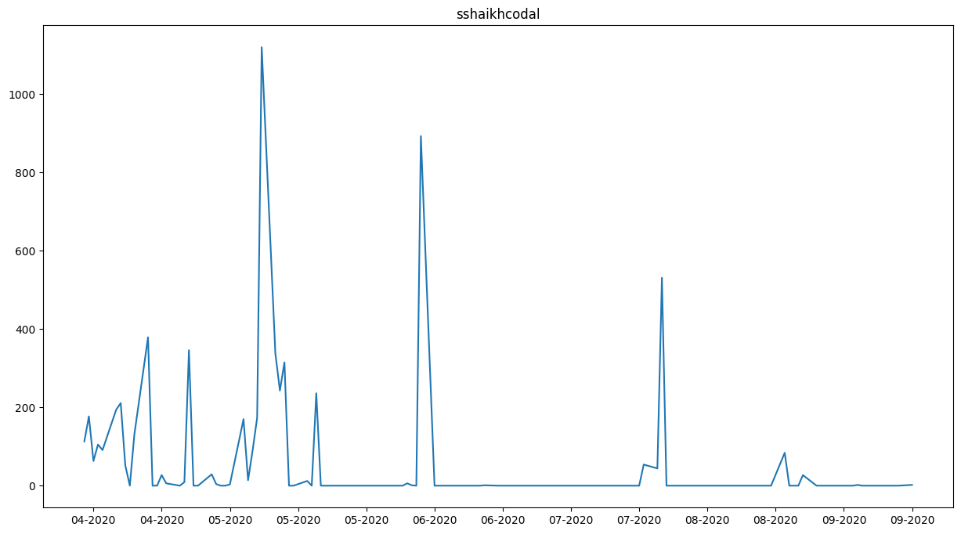
Regularity

Slide 57
Regularity
Metric for regularity = Sum of average commit per week for whole duration / Number of Weeks,
  Where average commit per week = Total Number of Commits in a week/7

Slide 58
Final Result
For final result, derived the aggregate of the contributor’s ranking across different measure of evaluation.

Slide 59
Conclusion
From above evaluations, we can get a coarse idea about the behavioural traits of a contributor with respect to his work.
Such measures can even be included in academic evaluations. For Example, these measures can be implemented to make sure students do their work regularly and consistently.
With the increased emphasis on version controlling in software industry nowadays, this implementation also provides the added benefit of preparing students for it.

Slide 60
Future Work
Commit Messages can be used to retrieve more information.
While this was a statistical insight, commit messages can be mined to get a linguistic insight about contributor behavior.
With reference to academic use , a deadline system can be implemented.
A metric can be developed to evaluate whether students submits before or after deadline and what is the deviation from it.
An automated module of this implementation can be integrated with the existing evaluation system.

Slide 61
References
Ciera Jaspan,Caitlin Sadowski. No Single Metric Captures Productivity, Rethinking Productivity In Software Engineering, 2019
Pratik P Bhoir, Harshali Patil. Evolution of Version Control Systems and a study on TortoiseSVN , International Research Journal of Engineering and Technology (IRJET), 2018
Natach Jongprasit and Twittie Senivongse. Software Developer Performance Measurement Based on Code Smells in Distributed Version Control System, International Conference on Software Engineering, Artificial Intelligence , Networking and Parallel/ Distributed Computing , 2019
Shu Li, Hayato Tsukiji, and Kosuke Takano. Analysis of Software Developer Activity on a Distributed Version Control System , 2016 30th International Conference on Advanced Information Networking and Applications Workshops (WAINA) , 2016
https://pygithub.readthedocs.io/en/latest/introduction.html
https://github.com/PyGithub/PyGithub
https://pandas.pydata.org
https://matplotlib.org

Slide 62
THANK YOU

